Slide 1
Part 3.2 Uses of HDF (continued)
Uses all slides

Slide 2
HDF5 and high speed detectors
Nick Rees
and Frederik Ferner, Greg Matthews, Tina Friedrich, Ulrik Pedersen, Matt Pearson, Jon Thompson, Tom Cobb, Tobias Richter, Mark Basham, Graeme Winter etc....

Slide 3
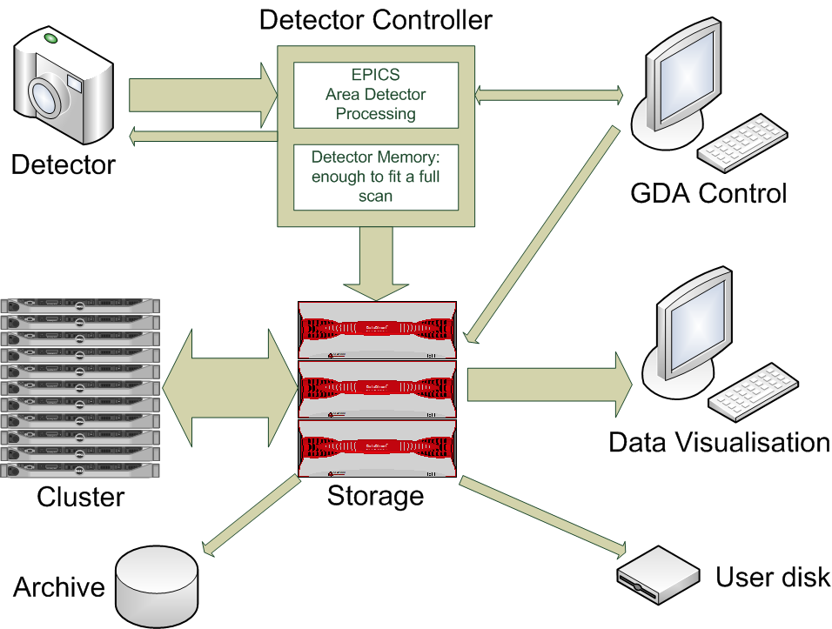
DLS High Data Rate Approach

Slide 4
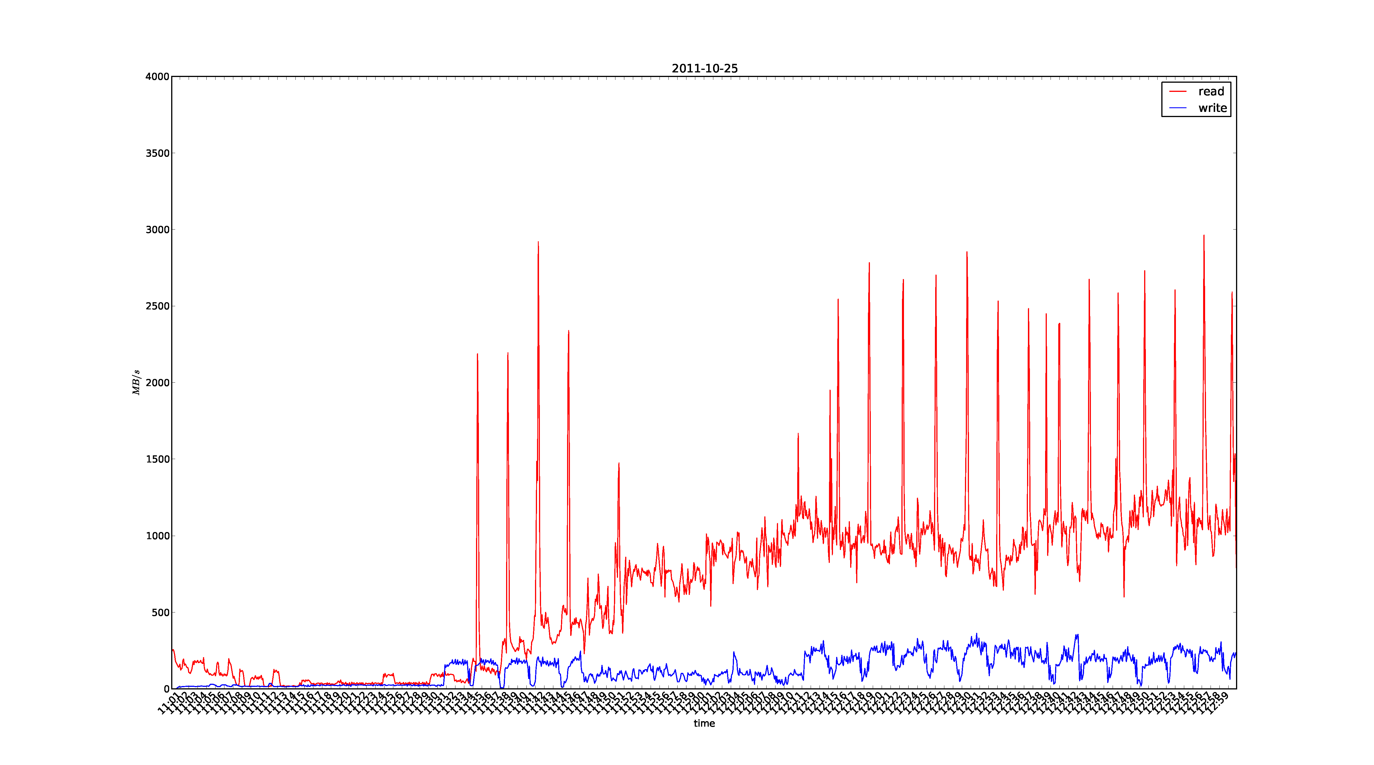
Data Rates while Data Taking
Read speeds
Write speeds
MB/s
0 500 1000 1500 2000 2500 3000 3500 4000
12:20 12:30 12:40 12:50 12:40
Time (minutes)

Slide 5
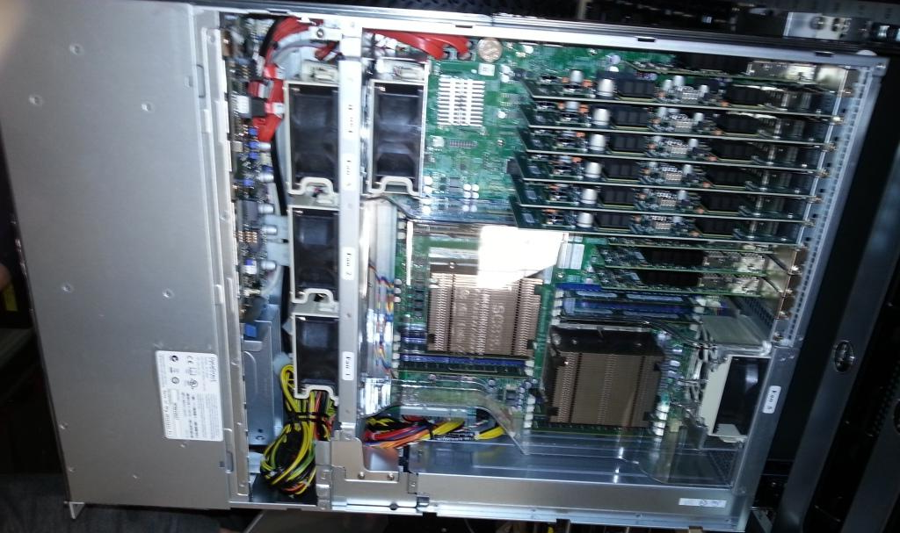
Modern Servers are Fast
DDN SFA12K-40
40 GB/sec controller pair
Each controller is a dual socket Supermicro Sandy Bridge system.
Runs a Linux variant
~ 10 GB/sec/socket throughput.
IB in one end, SAS out the other...

Slide 6
Typical modern detector
Master Node
FEM
Readout Node
FEM
Readout Node
Sensor/Medipix3 Hybrids
FEM
Readout Node
FEM
Readout Node
Network
FEM
Readout Node
FEM
Readout Node
Detector head
10GigE
Optical Links

Slide 7
Single Thread File Writes
Lustre 1.8
115 MB, 1 GbE
~400 MB/s, 10 GbE with checksums on
~750 MB/s, 10 GbE with checksums off
Reports of ~ 1100 MB/s with IB
Client thread saturates 100% of 1 core.
2.3.0 Servers, 1.8.8 Clients
~500 MB/s, 10 GbE with checksums on
~700 MB/s, 10 GbE with checksums off
2.3.0 Servers, 2.3.0 Clients
~440 MB/s, 10 GbE (no difference with or without checksums)
Big difference when writing less data than the client has RAM.
Servers are relatively old by today's standards (Dell 2970).
Still see some client thread saturation
GPFS
115 MB/s, 1 GbE
1150 MB/s, 10 GbE
2294 MB/s, 2 x 10 GbE
2100 MB/s, QDR IB

Slide 8
Some more numbers...
Aggregate file system throughputs:
First Diamond Lustre system: ~3 GB/sec
Second Diamond Lustre system: ~5-6 GB/sec
New Diamond GPFS system: > 20 GB/sec
Compression:
Dectris proposing LZ4
1.3 GB/sec/thread compression
Diffraction compression: 30-60x
BioSAXS compression: ~100x
Imaging compression: negligible...
However, in library HDF5 compression has a maximum throughput of ~500 MB/sec (for No-Op compression).

Slide 9
HDF5 pros and cons
Pros:
Extremely solid data model
Very high performance for simple data streaming.
A large number of features for high performance computing.
Widely used, de facto standard.
Extremely good support company – Dectris commented that The HDF Group was one of the best companies they had ever dealt with.
Large user community.
Cons
Non re-entrant, with a global library lock.
In-library data compression filters have a performance hit.
Files cannot be read an written simultaneously (yet).

Slide 10
HDF5 Data Files
EPICS and GDA both need to write the data file.
We use HDF5 links to create one logical file from multiple real files.
Avoids file contention issues.
Allows detector files to be highly optimised for performance.
The header data is written directly by GDA.
The detector data is written using EPICS HDF5 area detector plugin.
GDA
EPICS
Header Data .nxs file
HDF5 link
Detector Data .hdf5 file
HDF5 link
Detector Data .hdf5 file

Slide 11
Example: Tomography
Tomography scans are demanding:
Data rate ~ 500 MB/s.
Data size > 100 GB.
First operation is read data perpendicular to write direction.
Classic matrix transpose problem
Real challenge for typical cache design.
Completely unsuited to running inside the GDA server.
Image Frames
Sinogram Frames

Slide 12
Tomography data file format
Data must be optimised for reading sinograms.
All frames are written to a single file.
File is arranged in chunks of a fixed number of rows and a fixed number of frames.
The chunk size matches the Lustre stripe size so is written to a different Lustre server.
Data is in cache until all frames in a chunk are written.

Slide 13
Recent HDF5 developments
Last year the following developments were funded:
Writing of pre-compressed chunks.
Acquisition software can pre-compress data efficiently (i.e. in parallel), and write those directly to the HDF5 file without going through the HDF5 filtering mechanism.
Implemented by The HDF Group, funded by PSI and Dectris.
Filter plugins
User can supply a shared library at run-time that implements an HDF5 filter.
Allows the user to read and write compressed datasets with custom compression algorithms without recompiling the application by dynamically loading the corresponding filter.
Implemented by The HDF Group, funded by DESY.
Available in HDF5 1.8.11 (May 2013)

Slide 14
Future HDF5 developments
Single Writer Multiple Reader (SWMR)
Data can be added and modified, but file hierarchical structure cannot be changed.
Writer task pre-creates file structure and then enables SWMR.
Reader tasks open file with read-only and SWMR flags and can then read data as it becomes available.
A Reader always sees a consistent HDF5 file - no errors occur while reading HDF5 metadata and raw data.
If the Writer crashes, it leaves the file in a non-corrupted state.
There is no performance penalty for file access and modifications under SWMR.
Available in HDF5 v1.10.0 (2014)
Funded by Diamond, Dectris and ????

Slide 15
Future HDF5 developments
Independent parallel compressed writing
Allow multiple independent writers to write a compressed HDF5 in parallel
Each system actually writing a separate file, but there is a master file containing a “Virtual dataset” (VDS) that describes how the daughter datasets are joined together to make the parent dataset.
Has many other use cases, not just parallel compressed writing:
Manipulating NASA/GSFC National Polar-orbiting Partnership, Joint Polar Satellite System data files.
NASA Earth Science Data and Information System time series data
Currently developing requirements and use cases for implementation later this year.
Funded by Diamond and ???

Slide 16
Summary
Detectors are getting bigger and faster
With sufficient resources the data rates are manageable.
HDF5 is a great file format.
There are a few issues, but we are addressing many of them,

Slide 17
HDF5 and astronomy – LOFAR

Slide 18
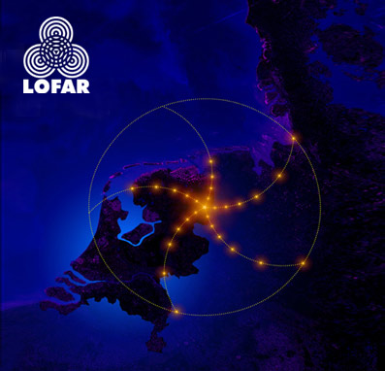

Slide 19
LOFAR Radiotelescope
LOFAR (LOw Frequency ARray) will be the largest radio telescope in the world.
LOFAR is a 'software' radiotelescope.
It is formed by a network of over 25000 small and simple antennas, which are distributed over several Dutch provinces as well as a part of Germany.
These antennas are connected to a supercomputer through an extensive glassfiber network.

Slide 20
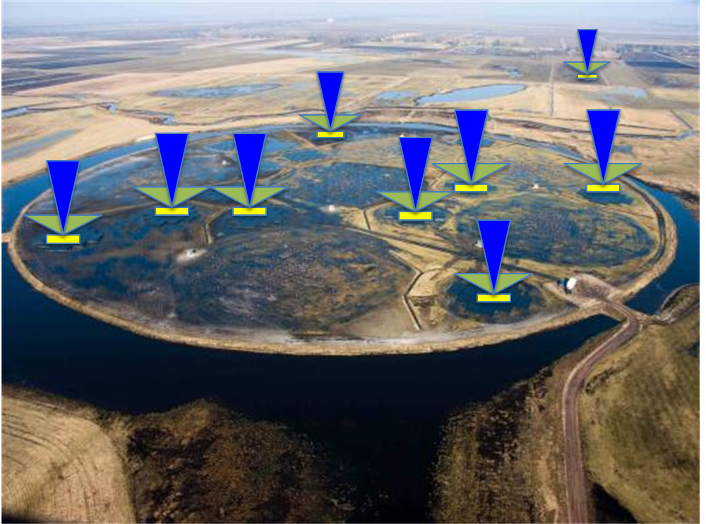
LOFAR “beams”

Slide 21
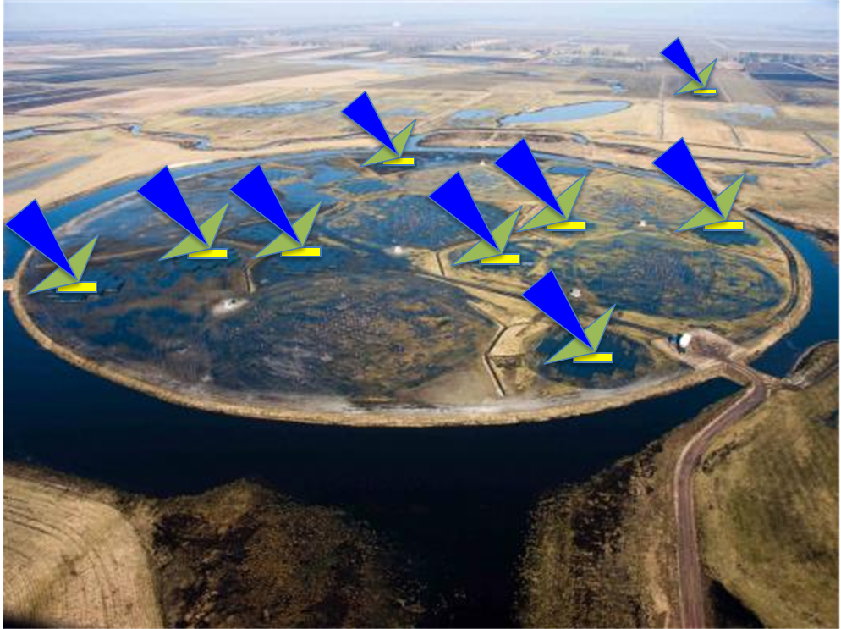
LOFAR “beams”

Slide 22
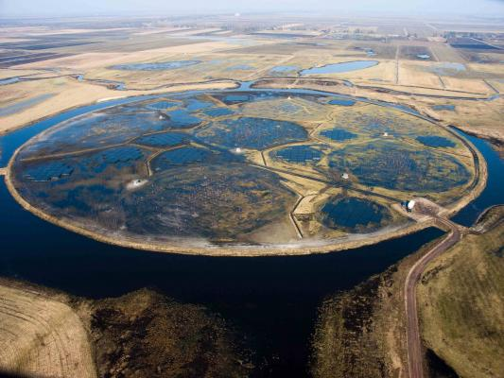
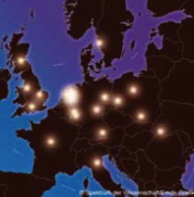
LOFAR “beams”
Multiple
Stations
Future:
40 stations (NL)
8+ stations (EUR)
Currently Operational:
30 stations (NL)
5 stations (EUR)
5.1 nano-second time resolution

Slide 23
Data Variety, Complexity and Size!
LOFAR has many observing modes [Imaging/Visibility Data, Beam-Forming (BF)/Time-Series, Transient Buffer Board (TBB) dumps, Rotation Measure Synthesis, etc]
Many different observing modes create data diversity/variety [6 basic LOFAR data types]
Using 30+ LOFAR stations creates enormous data rates and sizes [max ~23TB/hour = ~6MB/s]

Slide 24
LOFAR Sample Dataset Sizes
Exposure Time | Number of Subbands | Number of Stations | File Size Known Mode | File Size Search Mode
1 min | 248 | 5 | 11.2 GB | 56 GB
1 min | 248 | 20 | 11.2 GB | 244 GB
10 min | 248 | 5 | 112 GB | 560 GB
10 min | 248 | 10 | 112 GB | 1.1 TB
10 min | 248 | 20 | 112 GB | 2.2 TB
10 min | 248 | 30 | 112 GB | 3.3 TB
20 min | 248 | 5 | 224 GB | 1.1 TB
30 min | 248 | 5 | 336 GB | 1.7 TB
1 hr | 248 | 5 | 672 GB | 3.4 TB
1 hr | 248 | 10 | 672 GB | 6.7 TB
1 hr | 248 | 20 | 672 GB | 13.4 TB
1 hr | 248 | 30 | 672 GB | 26.8 TB
2 hr | 248 | 5 | 1.3 TB | 6.7 TB
12 hr | 248 | 5 | 8.0 TB | 40.3 TB
12 hr | 248 | 15 | 24.0 TB | 120.1 TB

Slide 25
Astronomical Data “Containers” (non-comprehensive list)
Binary
FITS (all wavelengths)
CASA [casacore] (Radio)
MBFITS
And many OTHERS (usually for ONE type of data)
Presto
apsr
asp
bcpm
bpsr
caspsr
cpsr
cpsr2
dada
dummy
fadc
fits
gmrt
lbadr
lbadr64
spda1k
mark4
mark5
maxim
mwa
pmdaq
puma
puma2
s2
sigproc
spigot
wapp
…As a result:
Software data I/O becomes a mess!
Tools have to be adapted per data container

Slide 26
Why LOFAR chose (yet) another data format: Hierarchical Data Format, version 5 (HDF5)
Question: Can only ONE of the astronomical formats (like FITS or CASA) do ALL these things?
HDF5 is a data model, library, and file format for storing and managing large and complex scientific data (images, N-D arrays, tables, metadata).
It supports an unlimited variety of datatypes, and is designed for flexible and efficient I/O and for high volume and complex data.
Self-describing and portable to a diversity of computational environments
No inherent file size limitations; no header Attributes/keys character length limits
C, C++, Java, Fortran 90 interfaces
Can be run on single node or massively parallel/distributed systems (~600 cores)
Built-in compression (GNU zlib, but can be replaced with others)
Parallel reading and writing (via MPI-I/O)
Partial I/O: “Chunked” (tiled) data for faster access
Free and in use for 20+ years by NASA and other projects
Inspection and visualization tools exist (HDFView + command line tools, Visit + pluggin, PyTables, h5py, MATLAB)

Slide 27
Datasets of the Future…
(in HDF5)
Future telescopes have similar challenges:
Radio: EVLA, ALMA, ASKAP, MeerKAT, MWA, LWA, eMERLIN and SKA!
Non-Radio: Pan-Starrs, LSST, TMT, GMT, ELT
Collaborations needed to expand HDF5-usage and tool-set in astronomy
Time is ripe to solve this issue across wavelengths and projects; HDF5 is mature and used extensively in science
This is NOT just a “Radio-problem”, it’s an astronomical problem!
Thank You

Slide 28
http://www.youtube.com/watch?v=gHexvdaGygk

Slide 29
Combining HDF5 and RDBMS

Slide 30


Combining HDF5 and RDBMS
VISION “Proud of our past, with a Vision for Tomorrow”
Aberdeen Test Center

Slide 31
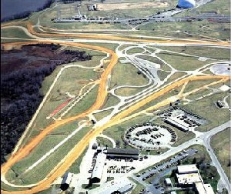
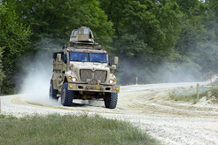

Slide 32
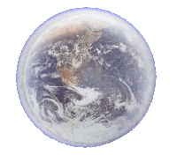
VISION
Knowledge Management Systems
Scripted Scenarios
Test Environment
High Speed Network
Internet
Analyst’s
Workstation
Integrated
Information Systems
*Adapted from “VISION” by Dr. Samuel F Harley, US Army Aberdeen Test Center. www.dtic.mil/ndia/2003NET3/harley.ppt

Slide 33
Database Methods Considered
Relational database with engineering unit data in tables
Relational database using BLObs and employing Just In Time (JIT) deblobing
Commercial Object-Relational Database
Relational database with engineering unit data in HDF-5 file system

Slide 34


Typical VISION Enterprise HDF5 File Layout
/ (root)
Versions
ChannelDataLabeled
EMETA
Modifications
Purged Channels
Verifications
ChannelData
RMETA
Res_Obj
Misc_Images
Configuration
Validation_Messages
Instrumentation Specific
.
.
.
Date/What
Changed
.
.
Same As ChannelData
Date/What
Changed
.
.
ORIGINAL_FILE_NAME
Instrumentation Specific
.
.
.
RES_UUID
CONFIG_UUID
INV_ID
AST_ID
CTR_ID
PRJ_ID
RES_TYPE
Res_Start_Time
Res_Stop_Time
BlobfileBytes
.
.
.
THUMBNAIL GPS MAP IMAGE (bytes)
ConfigFileUsed (string)
Hardlink
WIDE GPS MAP IMAGE (bytes)
Inventory_Item
Steer Angle (e.g. – Alias from config file)
13 (ID from EUDB)
Tax. params
.
.
.
Thumbnail_GIF (bytes)
ZOOMED GPS MAP IMAGE (bytes)
INV_NOTES
OFFSET_SEC
OFFSET_SEC Removed Data
PASSED VALIDATION CHECKS
Name/Reason
Project
FAILED VALIDATION CHECKS
Name/Reason
.
.
.
VALUE
VALUE Removed Data
Thumbnail_GIF All Data (bytes)
PRJ_NOTES
PRJ_NAME
PRJ_TC_NUMBER
MIN
AVG
MAX
NUMPTS
Extracted Features
Name/ Value
Legend
MIN
AVG
MAX
NUMPTS
TestCenter
.
.
.
.
.
.
Groups
CTR_Abbreviation
CTR_FullName
CTR_HomePage
Histogram
Attributes
Wed Oct 27 12:30:02 EDT 2004
.
.
.
Min,Max,NumBins,Mean,10%,90%,StdDev
BinDataArray
Data Sets
Thumbnail_GIF
Mime
BinDataArray Removed Data
.
.
.
Wed Oct 28 15:45:00 EDT 2004
MimeType
Extension
OriginalFileName
Data (bytes)
Thumbnail_GIF Removed Data
Monday, December 30, 2013

Slide 35
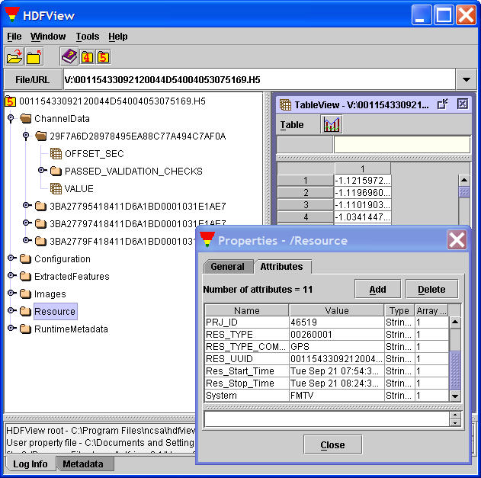
HDF-5 File System

Slide 36
The VISION Engineering Units Database – Simplified Diagram

Slide 37
Engineering Units Database And HDF-5 File System

Slide 38
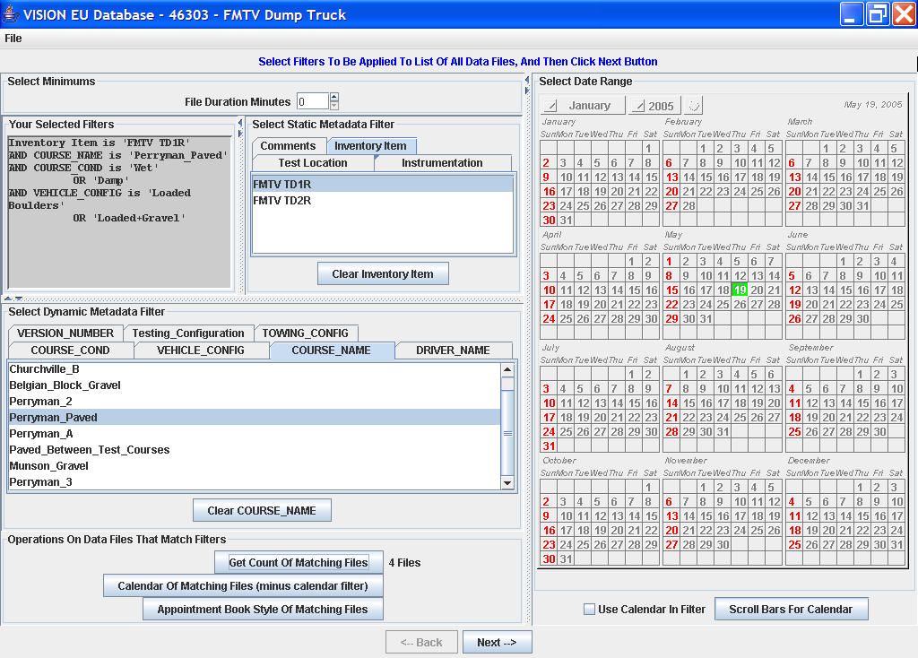
Test Item 1
Test Item 1
Test Item 1
Test Item 2

Slide 39
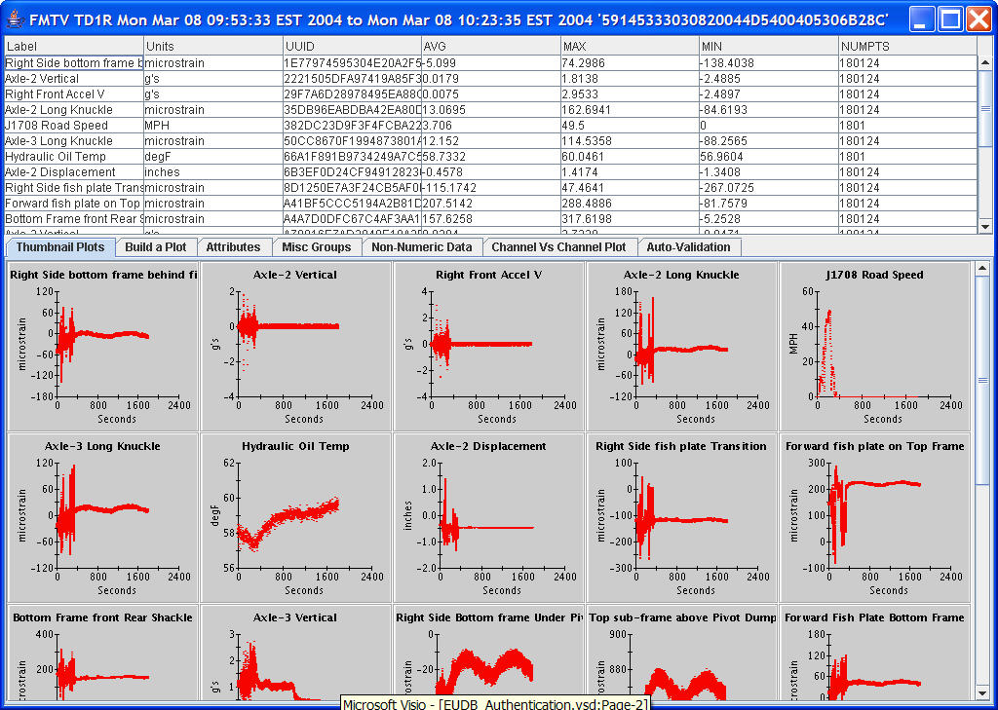
Test Item 1

Slide 40
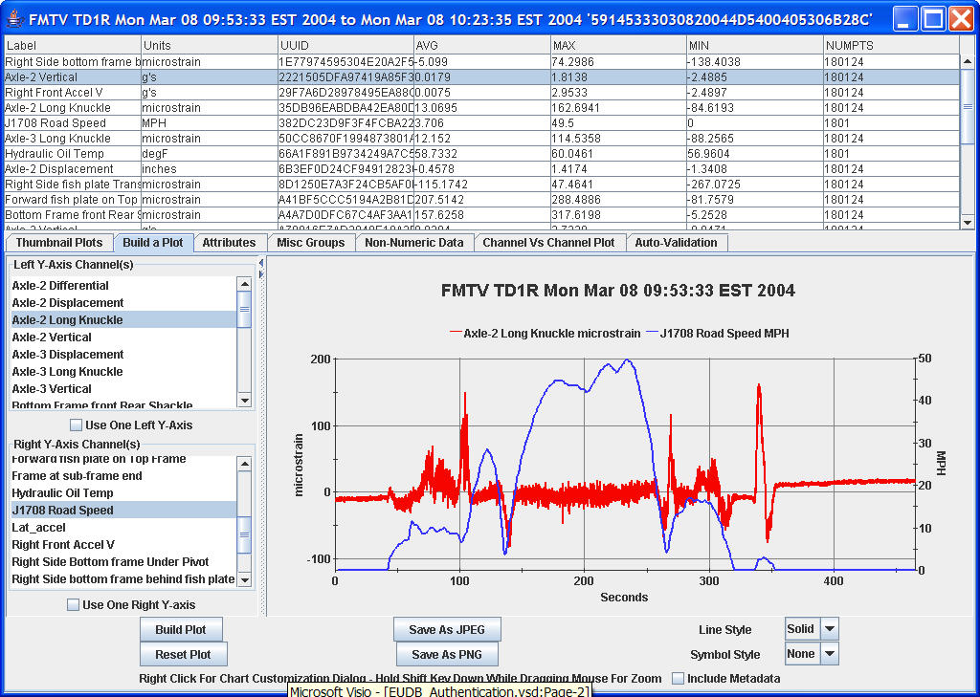
Test Item 1
Test Item 1

Slide 41
Seismic processing

Slide 42
V6.0

Slide 43
Getting Started With HDF5
Why have we brought in a new data format?
What actually is HDF5?
How do I create HDF5 files?
How do I read in HDF5 files
Reading one file at a time
Reading multiple files and selections
Points to Note
Future Developments

Slide 44
SEGY is great but…
It is designed to be read sequentially from tape
and our “index” file solution didn’t scale well to “big data”
and our index file solution only allowed primary key access
It only has 240 bytes of 32-bit integer headers defined
and our extended trace headers didn’t scale well to “big data”
Some processes require “n-key random access”
“surface consistent” suite, PreSTM, 3DSRME etc.
You need to read the whole file to access trace headers
Some “database” systems offer more flexibility
Parallel I/O doesn’t scale well on large clusters

Slide 45
So what is HDF5?
Developed over the last 20 years
Initially by National Centre for Supercomputing Applications http://www.ncsa.illinois.edu/
Now developed by the HDF5 Group http//:www.hdfgroup.org
A suite of technologies, not just a file format
General purpose library and file format for storing scientific data
Fully supported set of command line tools, APIs and interfaces
A pan-industry open standard
Used for storage by both MatLab and Scilab, can be read by Mathmatica
Fully supported set of command line tools, APIs and interfaces
A self describing format
No ambiguity about integer or floating point types or storage in trace bytes
Names can be allocated to components, as you would in a database structure
Built for “big data”
Petabyte+ scale datasets running on tens of thousands of cores

Slide 46
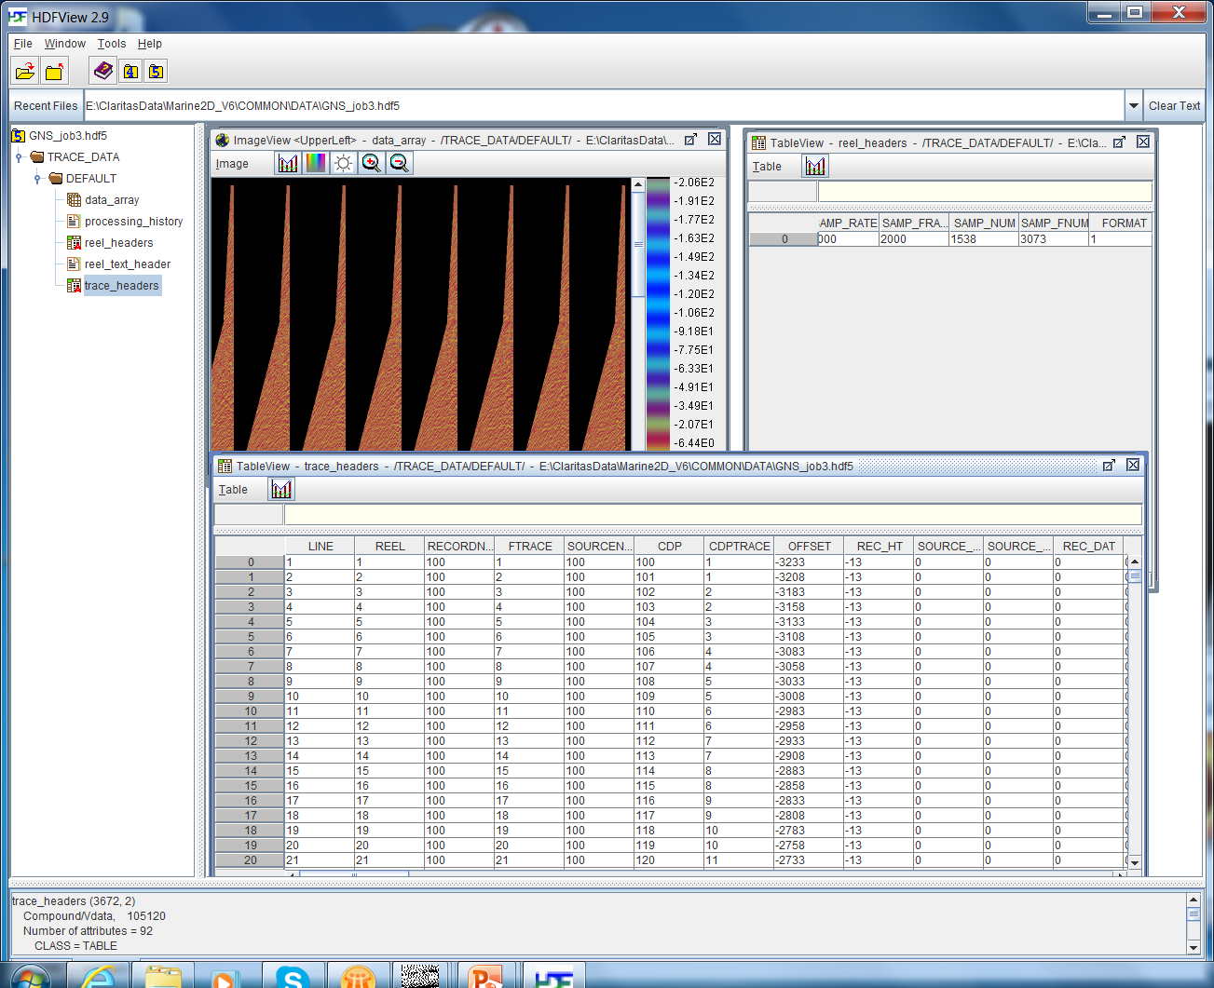
Our Implementation of HDF5
HDFView 2.9 : free, third party tool, showing how any HDF5 application can open the new format
Data, Processing History, 400-byte reel header, 3200-byte text header, history and trace headers from Claritas extended SEGY all present
Seismic samples displayed graphically – could also be displayed as a table
All trace headers – SEGY 240byte and extended - opened in a spreadsheet; full mathematical operations
The 400-byte binary reel header opened as a table, so that values can be edited or modified
We have “encapsulated” the GLOBE Claritas SEGY in HDF5

Slide 47
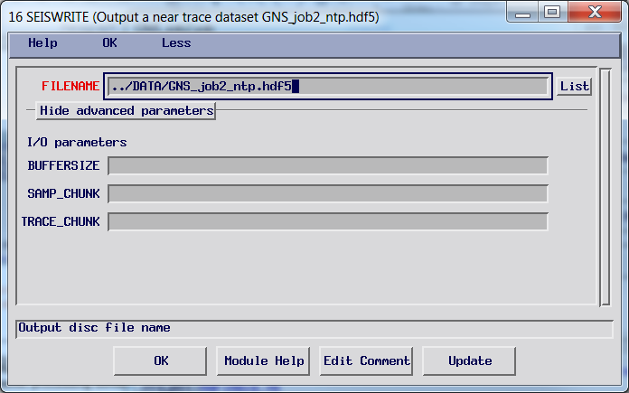
Creating HDF5 Files : SEISWRITE
Specify a file name!
Optimisation controls; these have smart defaults set and can be modified for managing very large datasets where you know that non-sequential read-access will be needed, or partial read of trace samples will be required
Replaces current use of DISCWRITE, although this will continue to be available
New functionality development will focus on SEISWRITE and HDF5 format data

Slide 48
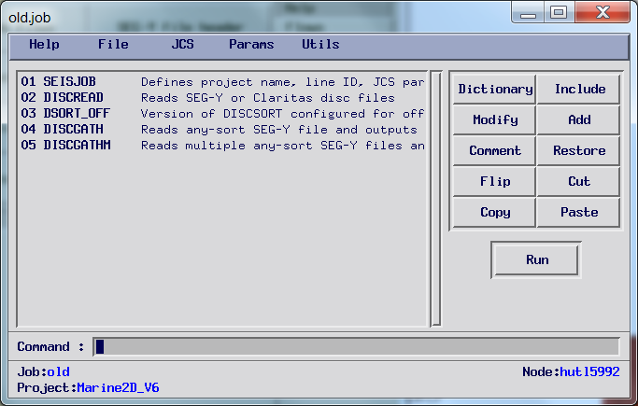
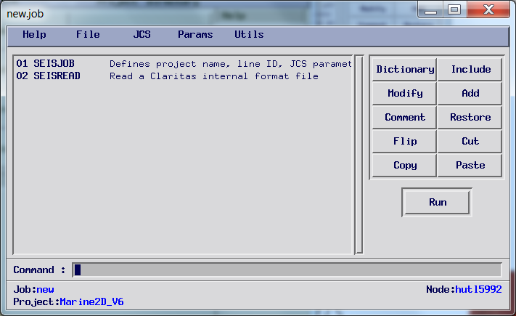
Reading HDF5 files : SEISREAD
With HDF5 format, you use SEISREAD in place of the DISCxxxxx Modules
You don’t need to worry about the order of data on disc, just how you want to read it

Slide 49
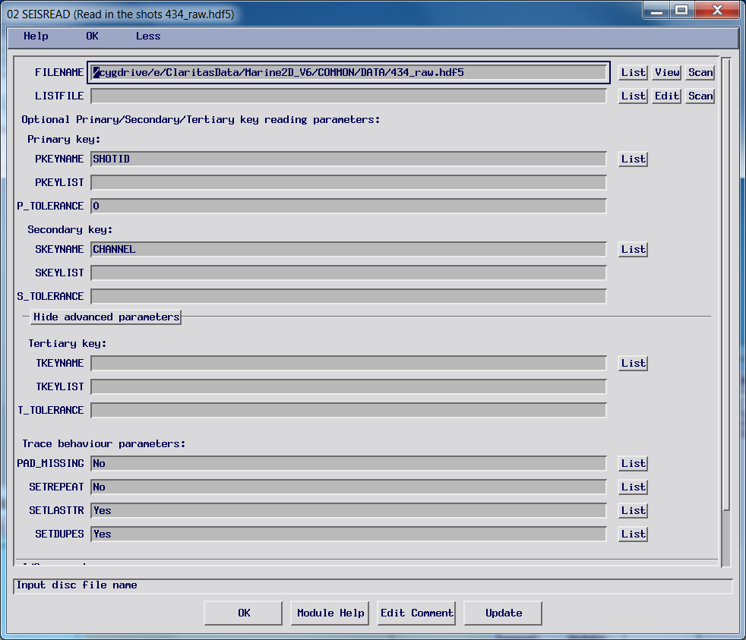
Simple Reading
File Name
Primary key order; default is all, ascending
Secondary key order; default is all, ascending
Tertiary key order; only when needed
You can read data in ANY order; original order doesn’t matter

Slide 50
Other Large data examples

Slide 51
Simulations – ASCI*
1992 nuclear test ban treaty
*Accelerated Strategic Computing Initiative

Slide 52
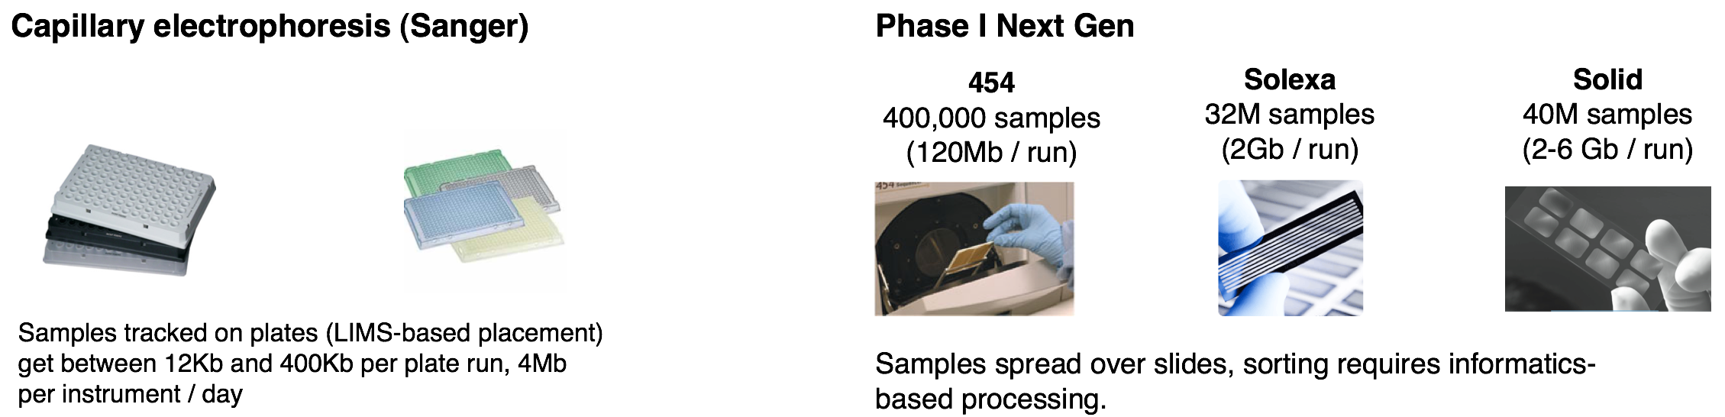
Next Generation DNA Sequencing
Next Gen Sequencing platforms produce ~1500 X more data than CE (Sanger)
A single Next Gen instrument can produce 20 times more data a single run than a day’s operation of a genome center with 100 CE instruments

Slide 53
An email …
“…We're doing genetic association studies, these result in large 2-d matrices (40K x 1M). Each of the cells in this matrix has ~10 numerical statistics… ”
40K x 1M x 10 x 4 = 1,600,000,000,000 (1.6 TB)

Slide 54
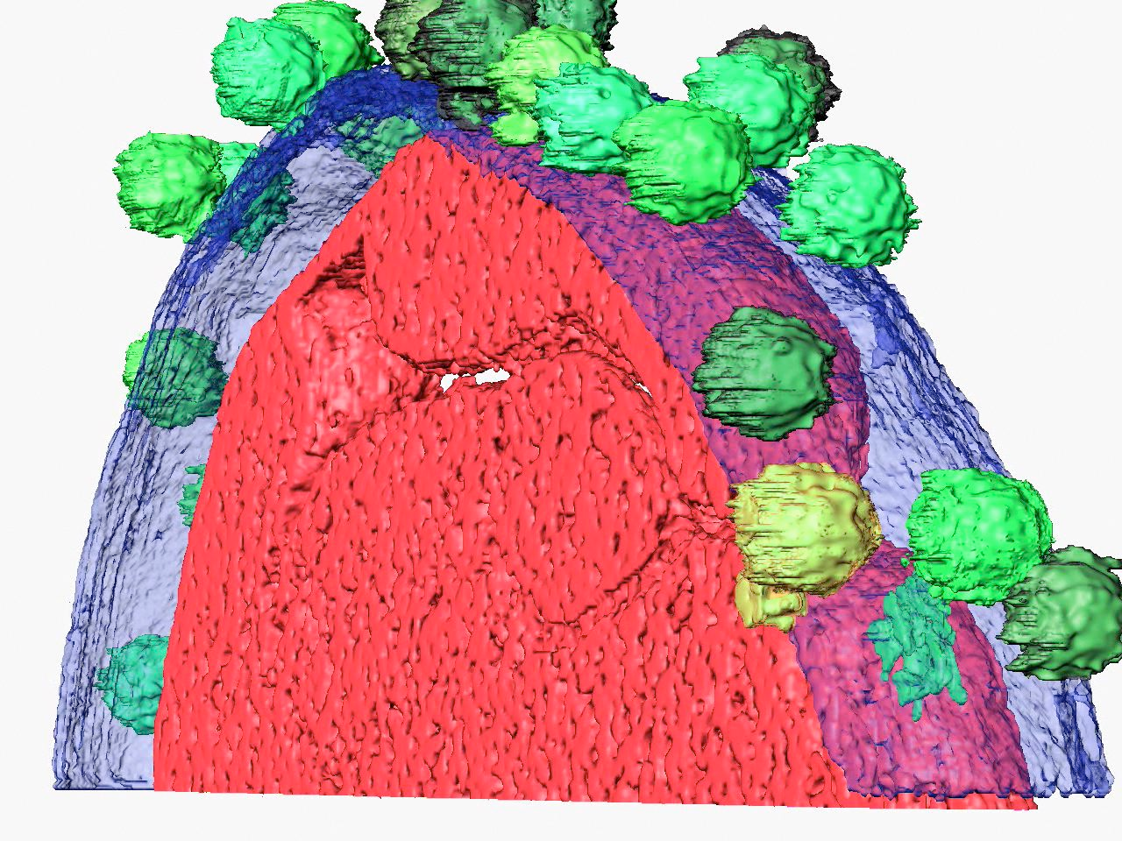
Electron tomography
25-80Å resolution
4k x 4k x 500 images now
8k x 8k x 1k images soon (256 GB)

Slide 55


Imageworks’ Field3D
Spiderman 3
The Polar Express

Slide 56
End of Part 3.2

